Slide 1


IEEE International Conference on Information, Implementation, and Innovation in Technology 2025
IEEE I2ITCON 2025
4th & 5th July 2025
Human Pose-Driven Fight Detection Using Random Forest and LSTM Architectures (Paper ID:2135)
K B S Karthik veera prajnaik
Designation
Lovely Professional University / Phagwara, India
4th July, 2025

Slide 2
Human Pose-Driven Fight Detection Using Random Forest and LSTM Architectures
1st K B S Karthik Veera prajnaik School of Computer Science and Engineering Lovely Professional University Phagwara, India. rajendrasrinivas1971@gmail.com
2nd Chirag Sharma Professor, School of Computer Science and Engineering Lovely Professional University Phagwara, India. Chiragsharma1510@gmail.com
3rd Tanya Nagpal Professor , School of Computer Science and Engineering Lovely Professional University Phagwara, India. Tanya.nagpal1989@gmail.com
4th Shubham Mahajan Professor , School of Computer Science and Engineering Amity University Gurgaon , India. mahajanshubham2232579@gmail.com

Slide 3
Introduction
Ensuring public safety through real-time detection of violent behavior is increasingly vital in crowded environments like streets, schools, and stations.
Traditional surveillance systems depend heavily on human monitoring, which is time-consuming, error-prone, and limited in scalability.
Visual features based on pixel intensity or background motion often misclassify actions due to occlusion, lighting, or crowd density.
This research leverages Media-Pipe, a Google-developed pose estimation framework that extracts human body landmarks with high precision.
By using these skeletal key points, we focus on understanding body posture and movement rather than color or motion.
Our model aims to automate fight detection using Random Forest, LSTM, and Bi-LSTM classifiers trained on pose features only.

Slide 4
Problem Description:
Manual video surveillance is inefficient and cannot consistently detect violent activity, especially in crowded or dim environments.
Existing automated systems rely on raw video pixels or motion vectors, which often result in false alarms or missed incidents.
Violent behaviors like punching or pushing may appear similar to casual gestures in pixel-based systems.
The lack of spatiotemporal reasoning and body dynamics understanding is a key limitation in many approaches.
Real-time intervention is critical, and delay in detection can lead to serious outcomes.
Therefore, we propose an AI-driven system that processes pose-based data to accurately detect aggressive behavior.

Slide 5
Objectives of research:
To develop a deep learning-based fight detection system using only pose key points extracted from video frames.
Use Media-Pipe Pose to generate a set of 33 landmarks per person, capturing upper and lower body motion.
Convert these spatial pose landmarks into time-series features for effective training of sequential models like LSTM.
Compare multiple models—Random Forest, LSTM, and Bi-LSTM—for accuracy, loss, and robustness on limited data.
Evaluate system performance in terms of real-time applicability, minimal false positives, and ease of deployment.
Recommend an optimal model architecture that balances accuracy and computational efficiency for practical surveillance systems.

Slide 6
Dataset and Feature Extraction:
The dataset consists of 300 labeled video clips (150 fight and 150 non-fight), each around 2 seconds long.
Media-Pipe Pose framework was employed to extract 33 key points (x, y, z, and visibility) per person in each frame.
From each video, 30 frames were sampled and preprocessed uniformly to ensure consistent data structure.
Each frame contributed 132 pose features, resulting in a fixed-length feature sequence per video sample.
Data normalization was performed to reduce scale bias, and padding handled missing frame data.
This structured and clean input allowed better training for time-series models while avoiding pixel noise.

Slide 7
Machine Learning Models used:
Random Forest was used as a classical ML baseline due to its effectiveness on structured data and low training time.
LSTM (Long Short-Term Memory) was chosen to capture the temporal evolution of body movements across frames.
Bi-LSTM (Bidirectional LSTM) further improves temporal learning by analyzing sequences in both forward and backward directions.
TensorFlow and Keras were used for implementing deep learning models, with early stopping and dropout layers to prevent overfitting.
The models were trained over 30 epochs with batch sizes of 16 and 32, using Adam optimizer and ReLU activation.
Media-Pipe pose sequences served as the input, converting raw movement into informative, model-friendly data.

Slide 8
Model’s Comparison:
Model | Training Accuracy | Validation Accuracy
Random Forest Classifier | 0.95(95%) | 0.63(63%)
LSTM Model | 0.7016(70.16%) | 0.75(75%)
Bi-LSTM Model | 0.6179(61.79%) | 0.65(65%)
LSTM achieved the highest validation accuracy, effectively learning from the temporal structure of pose features.
Random Forest performed well on training data but showed overfitting, lacking the ability to model frame-by-frame transitions.
Bi-LSTM had excellent training accuracy but generalization was limited, likely due to dataset size and increased model complexity.
Media-Pipe features proved effective across all models, offering a cleaner and more meaningful representation than pixel or optical flow features.
The comparison confirmed that LSTM offers the best balance between accuracy, simplicity, and generalization.

Slide 9
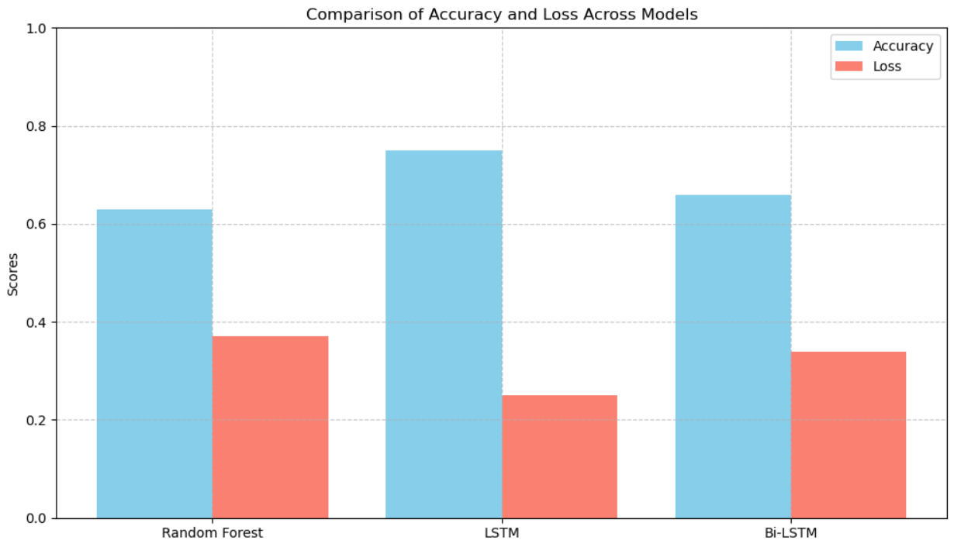
Results and Accuracy:
LSTM had highest validation accuracy (75%)
Bi-LSTM: slight overfitting due to complexity
Random Forest: good performance but less dynamic
Media-Pipe features reduced false positives
Loss minimized with proper temporal modeling
LSTM output closely matched ground truth

Slide 10
Conclusion:
Pose-based detection using Media-Pipe is an effective, lightweight alternative to motion or pixel-based systems.
Among the three models tested, LSTM provided the best performance on unseen data, balancing accuracy and robustness.
Random Forest, while fast and interpretable, lacked temporal modeling, limiting its real-time use.
Bi-LSTM offered slightly improved learning capacity but required more data to avoid overfitting.
Media-Pipe's reliable key point extraction enabled our models to focus on core movement patterns, reducing background noise issues.
The system has real-world potential in surveillance environments to automatically flag violent actions.

Slide 11
Future Scope:
Increase dataset size with more real-world fight and non-fight scenarios to improve model robustness.
Use Media-Pipe Holistic to integrate pose, face, and hand landmarks for richer feature extraction.
Explore CNN-LSTM and Graph Neural Network architectures to further improve spatiotemporal understanding.
Incorporate environmental context like audio or crowd density to increase decision accuracy.
Optimize models for edge deployment on CCTV cameras or embedded systems with real-time alert systems.
Collaborate with law enforcement agencies to test and deploy the system in public safety infrastructure

Slide 12
Thank You!!
K B S Karthik veera prajnaik
Mobile No: +91 9573705162
Mail ID: rajendrasrinivas1971@gmail.com

